Slide 1



Smart Bus Fee Verification System
TEAM MEMBERS:
DHANU SHREE (25ITR021)
ESAIMOZHI (25ITR033)
HARINI P (25ITR041)
HARINI SREE (25ITR042)
INBARASI E (25ITR048)
Course : 24ITL34 – DESIGN THINKING LABORATORY
Exercise : 2 – PERFORM USER RESEARCH BY USING EXPLORE METHOD & TOOLS
Date : 09.10.2026

Slide 2

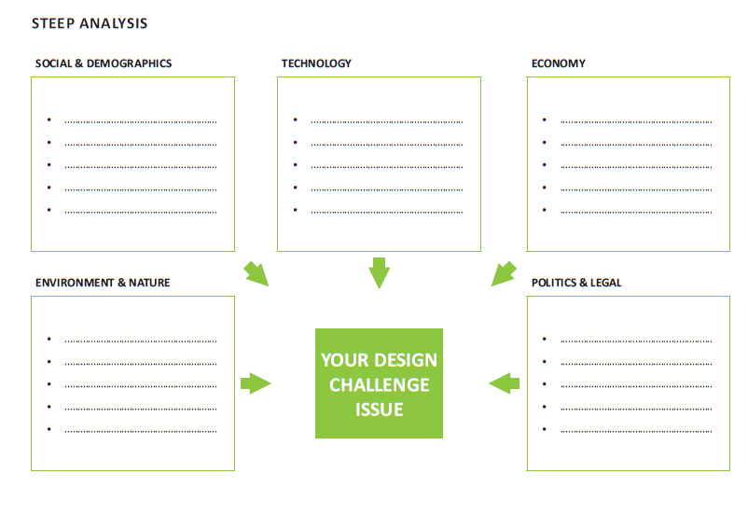
T2 : STEEP Trends Analysis
SOCIAL
Large student population
Students expect quick boarding
Need clear fee-status communication
TECHNOLOGICAL
QR/Student ID scanning
Digital payment records
Real-time database access
ECONOMIC
Low-cost implementation
Reduce staff time
Affordable maintenance
ENVIRONMENT & NATURE
Less paper-based record keeping
Reduced printing and manual registers
POLITICAL / LEGAL
Protect student payment data
Restrict access to authorised staff
Follow college payment procedures
DESIGN CHALLENGE:
Fast, accurate bus-fee checks

Slide 3
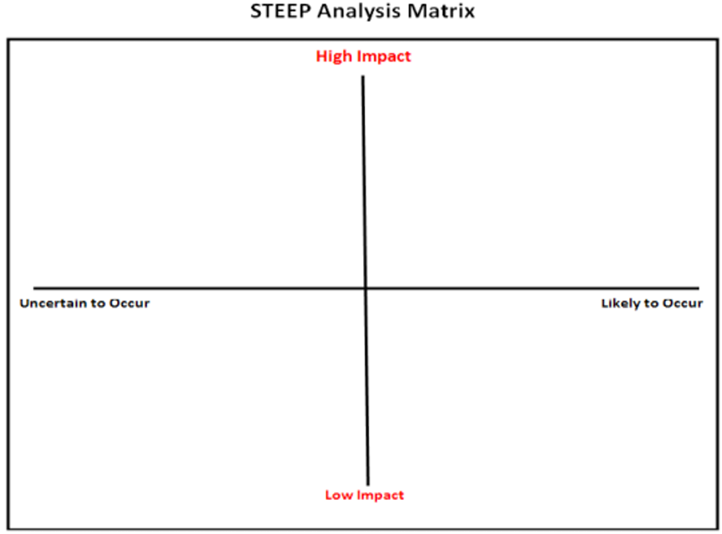
T3 : STEEP Analysis Matrix
HIGH IMPACT / UNCERTAIN
• Internet may be unstable at boarding
• Payment records may not update instantly
HIGH IMPACT / LIKELY
• Faster QR/ID-based verification
• More students need quick boarding
LOWER IMPACT / UNCERTAIN
• Device availability may vary
• Some users may need training
LOWER IMPACT / LIKELY
• Digital records reduce paperwork
• Reports help routine administration

Slide 4
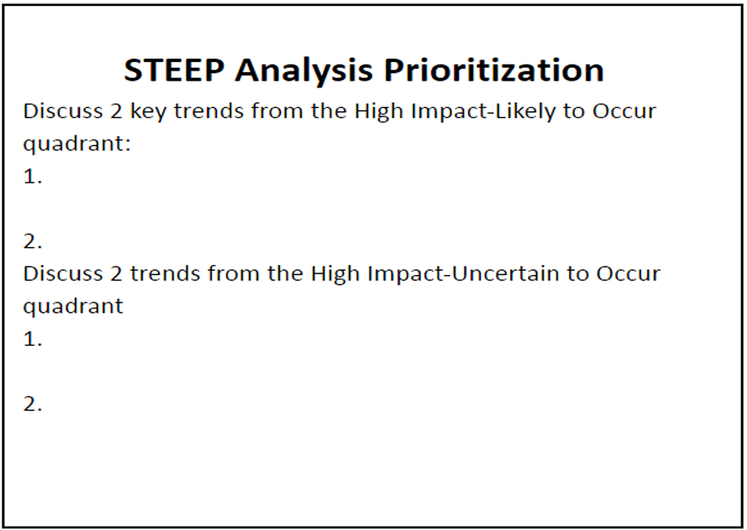
T4 : STEEP Analysis Prioritization
HIGH IMPACT – LIKELY TO OCCUR
Manual fee checking causes boarding delays.
QR/Student ID scanning can speed up verification.
HIGH IMPACT – UNCERTAIN TO OCCUR
Internet failure may interrupt live verification.
Delays in payment updates may show an incorrect status.

Slide 5
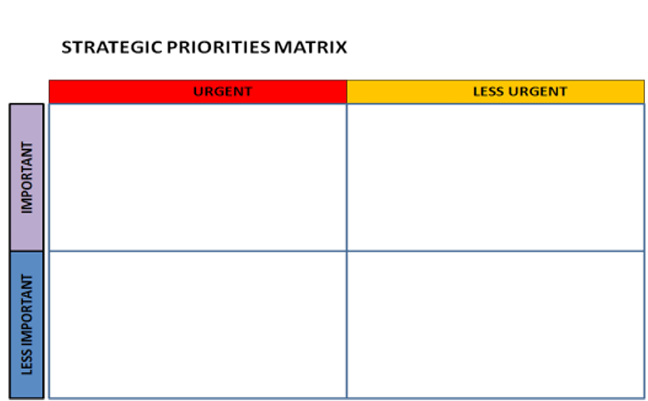
T5 : Strategic Priorities Matrix
URGENT + IMPORTANT
• Build reliable fee-status lookup
• Verify using QR code / Student ID
• Show clear paid / pending status
LESS URGENT + IMPORTANT
• Generate periodic reports
• Improve dashboard layout
• Add user guidance
URGENT + LESS IMPORTANT
• Train staff before deployment
• Prepare a simple fallback checklist
LESS URGENT + LESS IMPORTANT
• Decorative interface changes
• Features outside the project scope

Slide 6
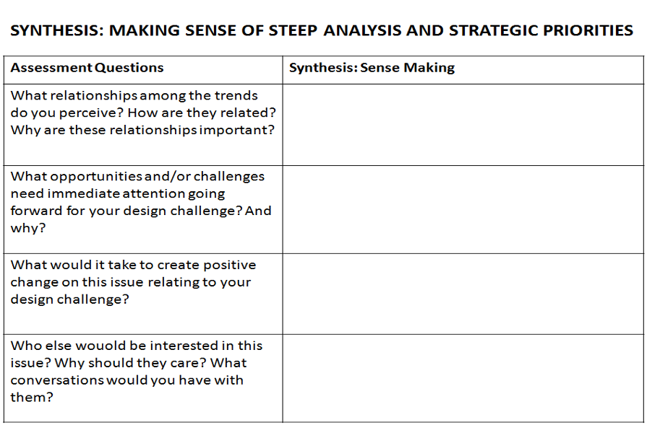
T6 : Synthesis (Sense Making)
Manual checks take time; large queues create boarding delays.
Staff need a quick, dependable way to confirm whether a student's bus fee is paid.
Human error, difficult defaulter identification and scattered records.
Use one secure database and a QR/Student ID lookup with clear payment status.
Students should board without unnecessary waiting or repeated checks.
Design a fast process, test with staff and students, and provide a fallback for connectivity issues.
Transport staff, students and accounts staff all depend on accurate records.
Keep access authorised, records updated, and communication simple for every user group.

Slide 7
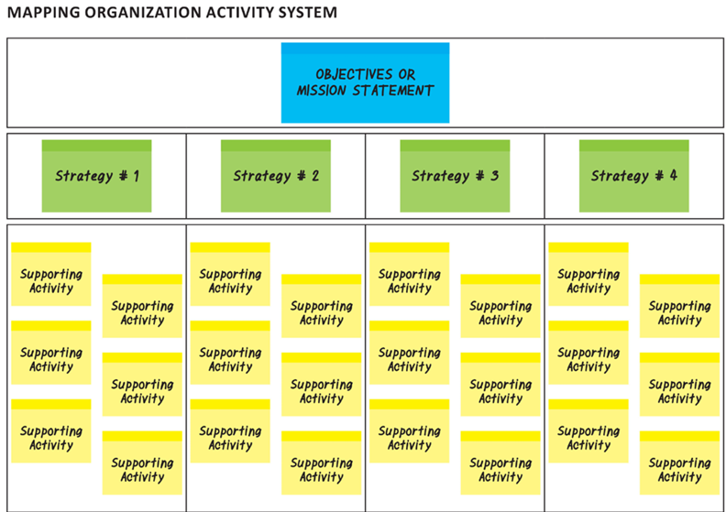
T7 : Activity System Mapping
OBJECTIVE: Verify bus-fee status quickly and accurately
Strategy 1
Digitise records
Strategy 2
Scan ID/QR
Strategy 3
Show status
Strategy 4
Track & report
Register student
Store student ID
Link fee record
Scan QR / ID
Fetch student
Validate status
Show paid/pending
Flag defaulter
Give clear message
Notify relevant user
Generate report
Review exceptions
Capture payment
Update database
Check record
Secure access
Back up records
Handle offline case

Slide 8
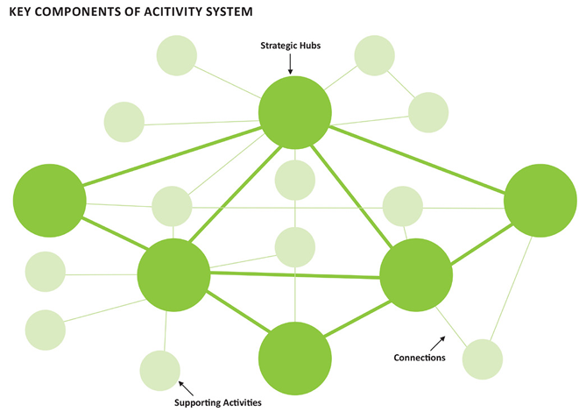
T8 : Key Components of Activity System
SMART BUS FEE VERIFICATION
Bus Conductor
Boards students
Students
Student ID / QR
Transport Officer
Checks payment
Secure Database
Fee-status records
Accounts Team
Updates payments
College Admin
Policy & oversight

Slide 9
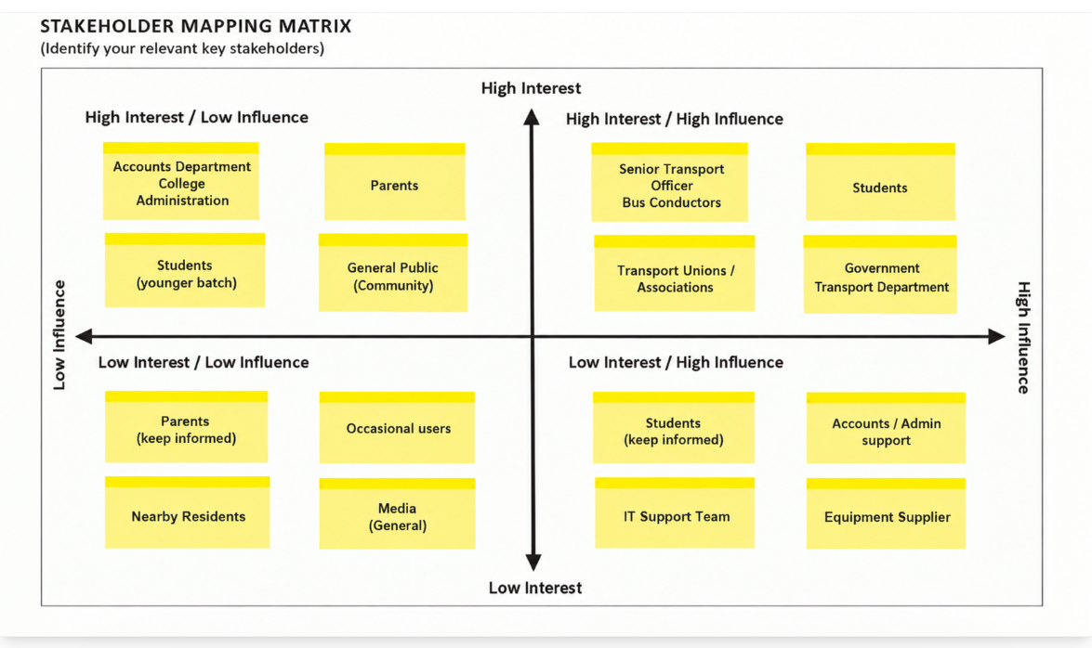
T9 : Stakeholder Mapping Matrix

Slide 10
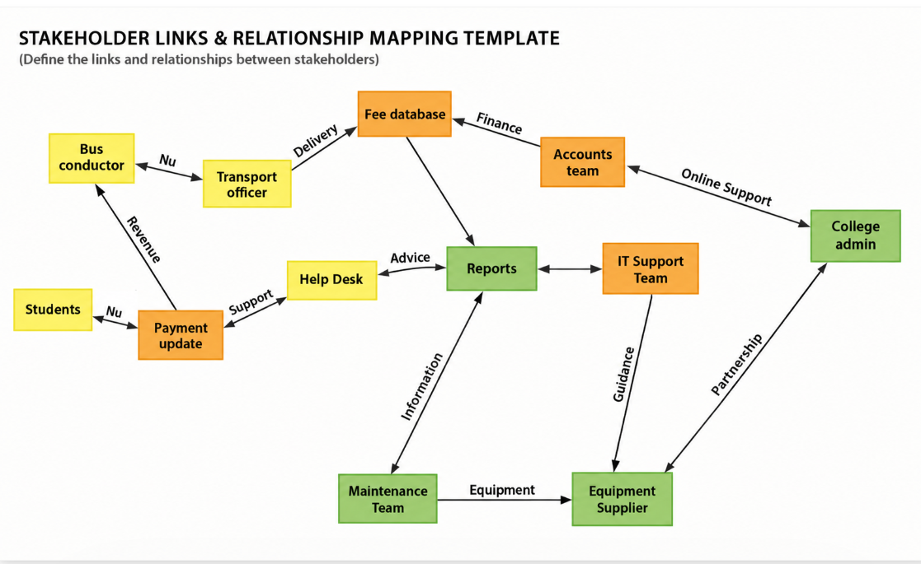
T10 : Stakeholder Links & Relationship Mapping

Slide 11
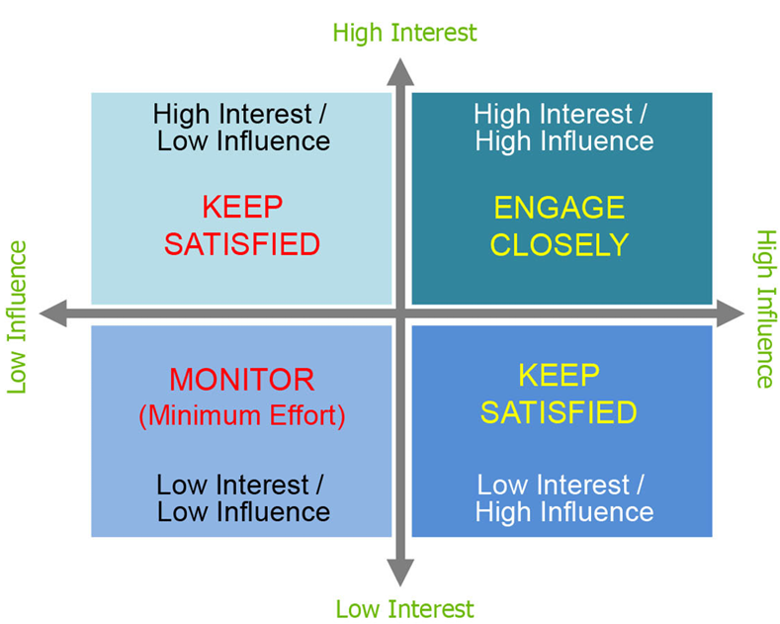
T11 : Stakeholder Priority Mapping Matrix
Transport Officer
Bus Conductors
Accounts Department
College Administration
Parents
Students

Slide 12
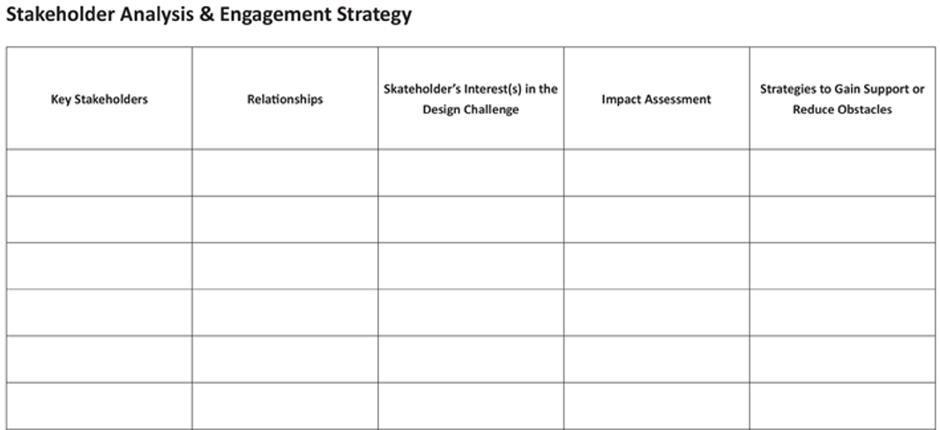
T12 : Stakeholder Analysis & Engagement Strategy
Stakeholder
Role / Need
Interest
Influence
Engagement Strategy
Transport Officer
Verify fee status quickly
High
High
Involve in testing; collect feedback
Bus Conductors
Confirm boarding eligibility
High
Medium
Short training and clear workflow
Students
Fast, fair verification
High
Medium
Explain QR/ID use and status messages
Accounts Dept.
Maintain correct payment data
High
High
Agree on update process; review exceptions
Parents
Confidence in fee records
Medium
Low
Provide clear notices through college
College Admin
Reliable transport process
Medium
High
Review reports and access policy

Slide 13
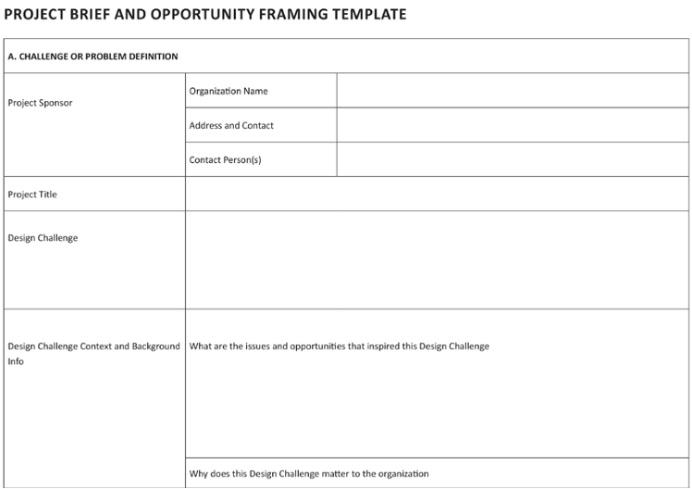
T13 : Project Brief & Opportunity Framing
Primary user: Transport Officer
Secondary: students, conductors, accounts
Need: fast, accurate, secure payment-status lookup
Smart Bus Fee Verification System
Reduce manual work, boarding delays, human errors and scattered records.
A low-cost, easy-to-maintain prototype for college transport operations.
Student registration; QR/ID scan; payment-status display; notifications; reports.
Use a secure database and a simple staff interface; verify in a few seconds.
Transport staff and students
Manual checking; queues
Slow, error-prone fee verification
Success measures: shorter verification time, fewer errors, accurate payment records, and positive staff/student feedback.

Slide 14
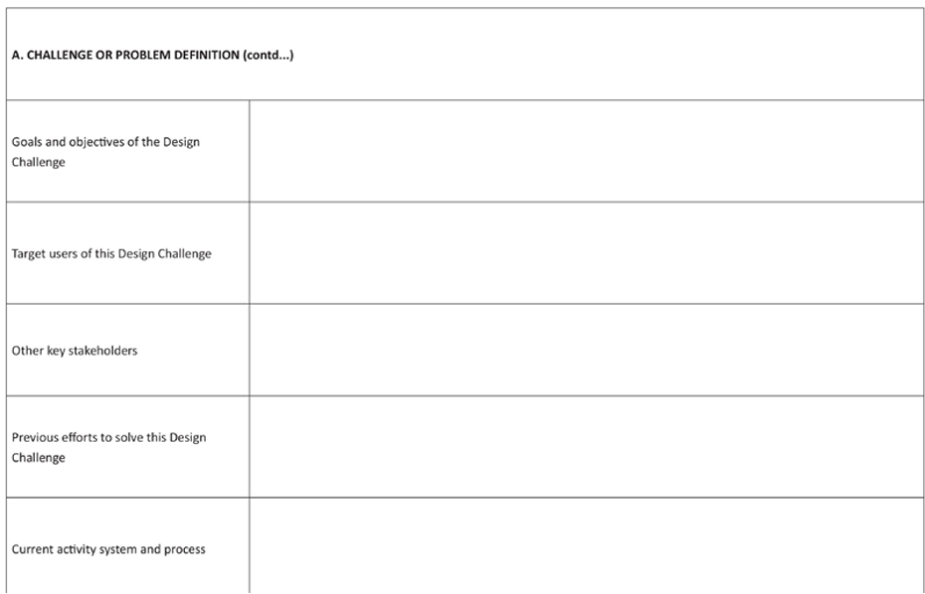
T13 : Project Brief & Opportunity Framing(contd..)
A student arrives at the college bus; staff must confirm fee payment before boarding.
Manual register checking and scattered payment information slow the queue.
Student registration, secure fee database, QR/ID scanning, status display and reports.
Student ID/QR, mobile device or scanner, internet, database, laptop and development tools.
8–10 weeks; team of 3–4 student developers with transport/admin input.
Connectivity issues, delayed payment updates, data privacy and staff training.

Slide 15

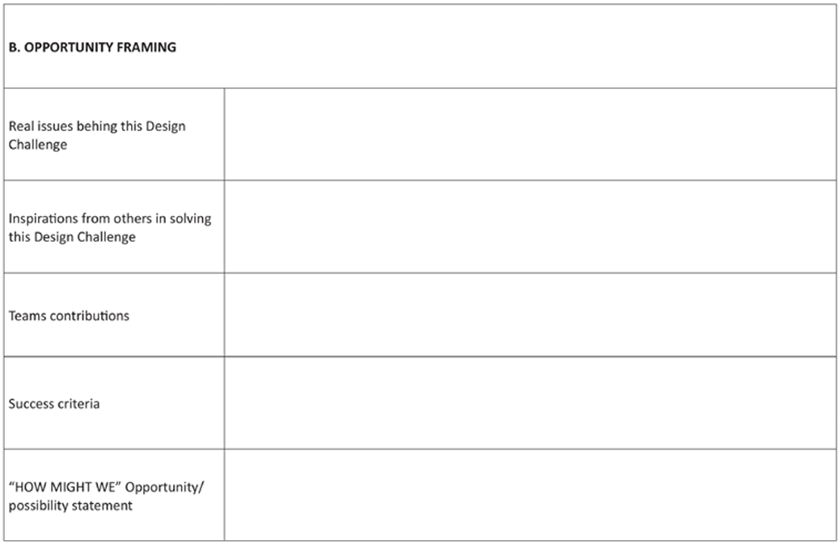
T14 : Project Brief & Reframing Project Challenges
How might we reduce the time needed to verify bus-fee payment?
How might we make payment status accurate and easy to understand?
How might we handle weak internet or delayed database updates?
How might we protect student records while allowing fast staff access?
How might we make the system affordable and simple to maintain?
How might we help transport staff identify pending fees without delaying others?

Slide 16
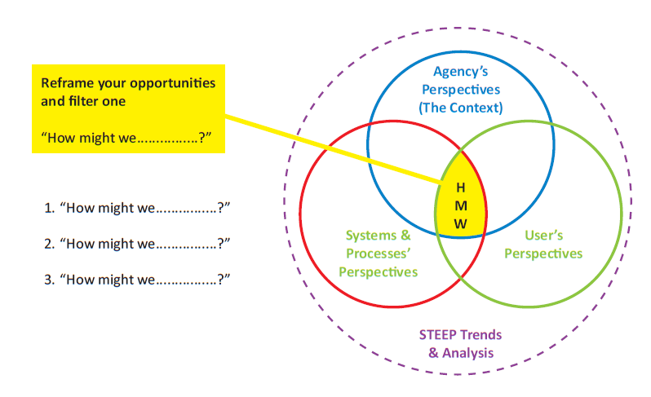
T15 : Reframing the Opportunities
Reframe our opportunities
and focus our design
User need: quick, clear fee confirmation
Opportunity:
Fast, accurate verification
Technical fit: QR/ID + secure database
Operational fit: low cost and easy to use
1. How might we verify payment in seconds?
2. How might we reduce manual errors?
3. How might we keep records secure?

Slide 17
References
□ IDEO Design Thinking Process
□ Interaction Design Foundation
□ Nielsen Norman Group – UX Research
□ Discussion with Senior Transport Officer (Sakthivel)
□ College Design Thinking Lab Notes
□ QR code / student-ID verification and secure database concepts
17

Slide 18
Ex. No. : 2 | Description | Reg. No.
Conduct of Experiment (30) | Empathize: Conduct user research to identify genuine needs. (5)
 | Define: Frame the right problem using insights. (10)
 | Ideate: Create creative solutions. (10)
 | Prototype: Model Creation (5)
Presentation (20) | Presentation & Reflection (10)
 | Depth of Research & Preparation (10)
Viva (10) | Communication & Clarity (5)
 | Response to Questions (5)
Faculty Signature

